Slide 1
Project Demo

Slide 2
Language Translation
Language Definition
Defined tokens
Create BoCoLa AST
Concrete BoCoLa example
Concrete BoCoLa AST
Visitor Pattern and Code Generation
Modification of runtime system
Extension of synchronization
Results

Slide 3
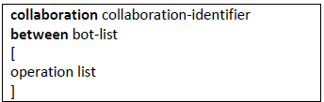
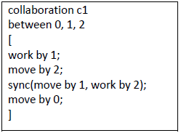
Language Definition
Collaboration abstraction – definition of what should be, reduce (or skip) the information how it is done
Extend BoCoLa with keyword sync:
Semantics: consist of two methods (method could be “work” or “move”), and these methods could be executed by bot(s) n
Contextual constrains: methods could be the same or different as well as bot number n, bot number n should be described in bot list

Slide 4
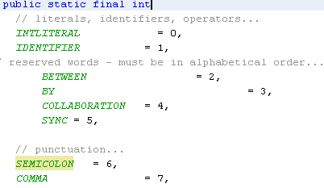
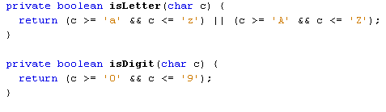
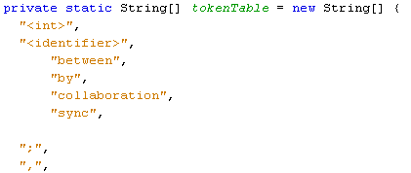
Defined Tokens
Tokens:
  between, by, collaboration, ;, [, ], EOF, …
Token.java class
Scanner.java class
Notes:
Token.java – in this class we defined all BoCoLa tokens
Scanner.java class is general rules to create tokens (it could be used Regex)

Slide 5
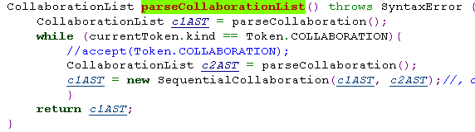
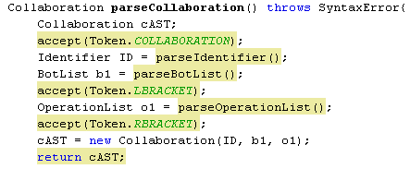
BoCoLa AST
Parser.java class
Sequential Collaboration
…
…
Collaboration ID
…

Slide 6
Concrete BoCoLa example
(Translation)
BoCoLa
Java
Java
Language | Syntax
BoCoLa | collaboration c1 between 0, 1, 2 [ sync(move by 1, work by 2); move by 0; ] collaboration c2 between 3,4,5 [ move by 5; work by 3; move by 4; ]
Java | Collaborations[No] = new Collaboration(); { Collaborations[No-1].include(new BotMethod.botMove(),Bot.bots[1],new BotMethod.botWork(),Bot.bots[2]); Collaborations[No-1].include(new BotMethod.botMove(),Bot.bots[0]); } Collaborations[No]=new Collaboration(); { Collaborations[No-1].include(new BotMethod.botMove(),Bot.bots[5]); Collaborations[No-1].include(new BotMethod.botWork(),Bot.bots[3]); Collaborations[No-1].include(new BotMethod.botMove(),Bot.bots[4]); }

Slide 7
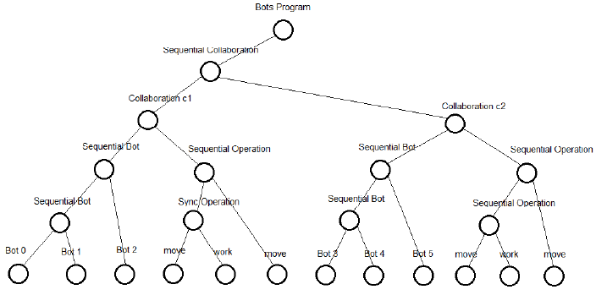
Concrete BoCoLa AST
Bots Program
Sequential Collaboration
Collaboration
Sequential Bot
Sequential Operation
move/work
Bot

Slide 8
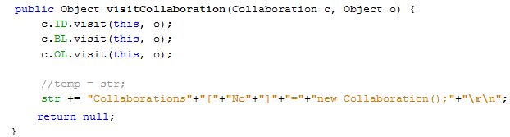

Visitor Pattern and Code Generation
Each tree node has method with parameter of visitor instance
Visitor node has methods with parameters of tree instances
Encoder.java
Generate code from BoCoLa to Java, by using Java
BoCoLa
Java
Java

Slide 9

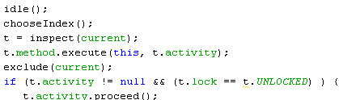

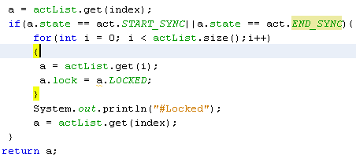
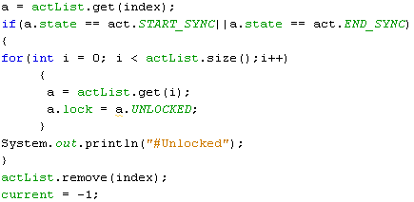
Modification of runtime system
Participant
Activity
Lock
Locked
Unlocked
Notes:
Modified runtime system allow us to execute in right order – synchronize. If in participant list there are synchronized bots when all other participants are locked and they have to wait until synchronized participants finish.

Slide 10
Extension of synchronization
sync
List of participants
Work
Move
null
sync
Move
Work
Move
null

Slide 11
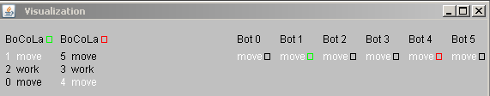
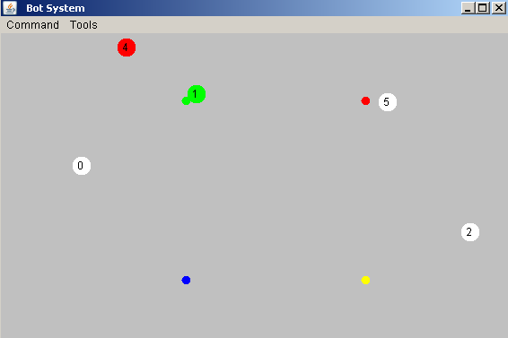
Results
Notes:
Picture of the Bots System runtime. Here are collaborations between bots.
By using the keyword sync it takes longer to execute, because of the wait. During synchronized bot execution no other bots execute. This guarantee right order of bots execution (move or/and work).

